Slide 1
Lecture 9 Self-Balancing Trees
Department of Computer Science
Hofstra University
Acknowledgement: Lecture slides based on UofW Course on Data Structures

Slide 2
AVL Tree
AVL Tree: A balanced BST that maintains the invariant: |LeftHeight – RightHeight | <= 1 for all nodes in the tree.
Named after Adelson-Velsky and Landis
But also A Very Lovable Tree!
node
Left
Height
Right
Height
An AVL Tree has height ≈ log(n)
Notes:
A balanced BST maintains the invariant |LeftHeight – RightHeight | <=1 for all nodes in the tree. It minimizes the BST height.

Slide 3
Measuring Balance
Measuring balance:
For each node, compare the heights of its two subtrees
Balanced when the difference in heights between subtrees is no greater than 1
8
10
8
7
7
9
15
Balanced
7
Balanced
12
18
Balanced
Unbalanced

Slide 4
Is this a valid AVL tree?
7
Is it…
Binary
BST
Balanced?
yes
yes
4
10
yes
3
5
9
12
2
6
8
11
13
14

Slide 5
Is this a valid AVL tree?
6
Is it…
Binary
BST
Balanced?
yes
yes
2
8
no
Height = 0
Height = 2
1
4
7
12
3
5
10
13
9
11

Slide 6

Time Complexity
INVARIANT
INVARIANT
public boolean containsKey(node, key) {
// find key
}
public boolean insert(node, key) {
// find where key would go
// insert
}
INVARIANT
INVARIANT
containsKey benefits from invariant: worst-case O(log n) time
Insert benefits from invariant:
worst-case O(log n) time to find location for key
How to maintain the invariant?
Track heights of subtrees
Detect any imbalance
Restore balance

Slide 7
BST containsKey()
The AVL Invariant
Rotations

Slide 8
Insertion
What happens if an insertion breaks the AVL invariant?
The AVL rebalances itself by rotations. AVL is a type of “Self-Balancing Tree”
A rotation alters the structure of a tree by rearranging subtrees.
Goal is to decrease the height of the tree to maximum height of O(log n).
Larger subtrees up, smaller subtrees down
Does not affect the order of elements
Time complexity O(1)
1
Insert 8
Rotation
5
1
5
1
8
5
8

Slide 9

Fixing AVL Invariant: Left Rotation
We can fix the AVL invariant by performing rotations wherever an imbalance was created
Left Rotation
Find the node that is violating the invariant (here, )
Let it “fall” left to become a left child
1
1
h:2
1
h:2
5
h:1
5
h:1
5
h:1
1
h:0
8
h:0
8
h:0
1
h:0
8
h:0
Apply a left rotation whenever the newly inserted node is located under the right child of the right child

Slide 10
Left Rotation: More Precisely
Subtrees are okay! They just come along for the ride.
Subtree 2 changes from left child of B to right child of A – but notice that its relationship with nodes A and B doesn’t change in the new position!
NODE
A
...
SUBTREE
2
...
A
B
1
B
A
C
2
C
1
2
3
4
A < 2
2 < B
3
4
A < 2
2 < B

Slide 11
Right Rotation
Right Rotation
Mirror image of Left Rotation!
NODE
A
...
SUBTREE
2
...
A
B
B
4
C
A
C
3
1
2
3
4
1
2
B < 3
3 < A
B < 3
3 < A

Slide 12
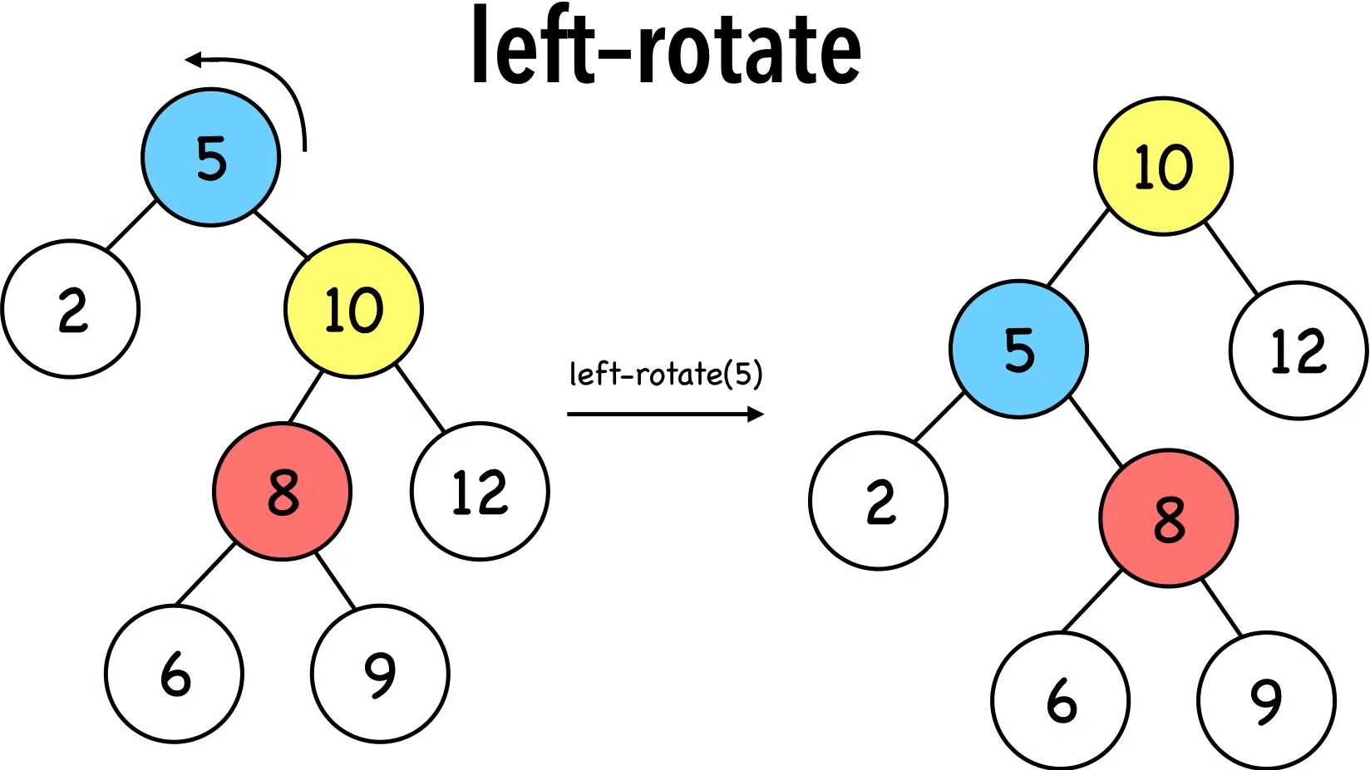
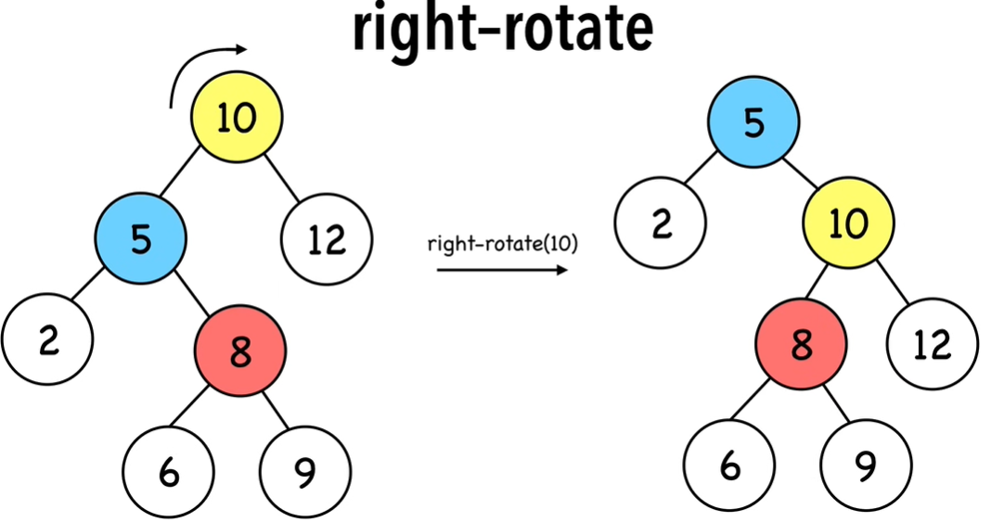
Left or Right Rotation Examples

Slide 13
Not Quite as Straightforward
What if there’s a “kink” in the tree where the insertion happened?
Can we apply a Left Rotation?
No, violates the BST invariant!
1
h:2
5
h:1
5
h:1
3
1
h:0
3
h:0
h:0

Slide 14
Right/Left Rotation
Solution: Right/Left Rotation
Two steps: First do a right rotation for the right two nodes. then do a left rotation for the three nodes.
Preserves BST invariant!
1
h:2
1
h:2
3
h:1
5
h:1
3
h:1
1
h:0
5
h:0
3
5
h:0
h:0
Notes:
rotate the bottom to the right, then rotate the whole thing to the left

Slide 15
Right/Left Rotation: More Precisely
Again, subtrees are invited to come with
Now 2 and 3 both have to hop, but all BST ordering properties are still preserved
(Note that A, B and C denote some numerical value, not letters ‘A’, ’B’, ’C’)
NODE
A
...
SUBTREE
2
A
...
B
C
1
4
A
B
C
1
2
3
4
2
3
A < 2
2 < C
C < 3
3 < B
A < 2
2 < C
C < 3
3 < B

Slide 16
Left/Right Rotation
Left/Right Rotation
Mirror image of Right/Left Rotation!
NODE
A
...
SUBTREE
2
A
...
4
C
B
B
A
1
C
1
2
3
4
2
3
B < 2
2 < C
C < 3
3 < A
B < 2
2 < C
C < 3
3 < A

Slide 17
AVL Example: 8,9,10,12,11
8
9
Insert 9
8
Insert 10
Left Rotation
8
9
8
10
9
10
9
9
9
Right/Left Rotation
Insert 12
Insert 11
8
10
8
11
8
10
12
12
10
12
11
Notes:
This is the line case.

Slide 18
AVL Example: 8,9,10,12,11
8
9
10
Notes:
Do a left rotation to correct

Slide 19
AVL Example: 8,9,10,12,11
9
8
10
12
11
Notes:
This is the kink case

Slide 20
AVL Example: 8,9,10,12,11
9
8
10
12
11
Notes:
Do a right rotation to get into a line case

Slide 21
AVL Example: 8,9,10,12,11
9
8
10
11
12
Notes:
Now do a left rotation to re-balance the line!

Slide 22
AVL Example: 8,9,10,12,11
9
8
11
10
12
Notes:
Now do a left rotation to re-balance the line!

Slide 23
Two AVL Cases
Line Case
Solve with 1 rotation
Kink Case
Solve with 2 rotations
3
1
1
3
2
2
3
1
1
3
2
2
Rotate Right
Rotate Left
Right Kink Resolution
Right/Left Rotation
Left Kink Resolution
Left/Right Rotation
Notes:
Parent’s left becomes child’s right
Child’s right becomes its parent Parent’s right becomes child’s left
Child’s left becomes its parent

Slide 24
How Long Does Rebalancing Take?
Assume we store in each node the height of its subtree.
How do we find an unbalanced node?
Go back up the tree from where we inserted.
How many rotations might we have to do?
Just a single or double rotation on the lowest unbalanced node.
A rotation will cause the subtree rooted where the rotation happens to have the same height it had before insertion
O(log n) time to traverse to a leaf of the tree
O(log n) time to find the imbalanced node
O(1) constant time to do the rotation(s)
Overall complexity: O(log n ) time for adding a node.
Notes:
the worst case for all interesting + common AVL methods (get/containsKey/put is logarithmic time)

Slide 25
AVL insertion: Approach
Overall algorithm:
Insert the new node as in a BST (a new leaf)
For each node on the path from the root to the new leaf:
The insertion may (or may not) have changed the node’s height
Detect height imbalance and perform a rotation to restore balance
Facts that make this easier:
Imbalances can only occur along the path from the new leaf to the root
We only have to address the lowest unbalanced node
Applying a rotation (or double rotation), restores the height of the subtree before the insertion -- when everything was balanced!
Therefore, we need at most one rebalancing operation

Slide 26
AVL insertion: Example
(1) Originally, whole tree balanced, and this subtree has height 2
...
...
6
6
...
8
...
10
7
2
8
2
10
12
9
12
7
9
11
(2) Insertion creates imbalance(s), including the subtree (8 is lowest unbalanced node)
11
(3) Left rotation on 8 will restore the subtree to height 2, whole tree balanced again!

Slide 27
AVL deletion
Deletion involves a similar set of rotations that let you rebalance an AVL tree after deleting an element
Omitted since it is beyond scope of this course
In the worst case, takes O(log n) time to rebalance after a deletion
Finding the node to delete is also O(log n), so total complexity is O(log n)

Slide 28
AVL Trees
PROS
CONS
All operations on an AVL Tree (search, insertion, deletion）have worst-case complexity O(log n)
Because the tree is always balanced!
Additional space for the height field
Rebalancing does incur some overhead
May not may not be important depending on the application
Notes:
Asymptotically, just better than a normal BST!
Operations: search, insert, remove, each with time complexity O(log(n)).

Slide 29
Video Tutorials
AVL Trees Simply Explained, Maaneth De Silva
https://www.youtube.com/watch?v=zP2xbKerIds
10.1 AVL Tree - Insertion and Rotations, Abdul Bari
https://www.youtube.com/watch?v=jDM6_TnYIqE
AVL tree insertion, InvesTime
https://www.youtube.com/watch?v=vQptSYake4E&list=PLoW1nQhPBiz_h5wcmoZODnVnQK9Xja-Pi&index=5
Inserting 14, 17, 11, 7, 53, 4, 13, 12, 8, 60, 19, 16, 20
In the middle of video (11 min) there is a typo where the root is written as 11, but it should be 14
Notes:
14, 17, 11, 7, 53, 4, 13, 12, 8, 60, 19, 16, 20

Slide 30
Red Black Trees

Slide 31
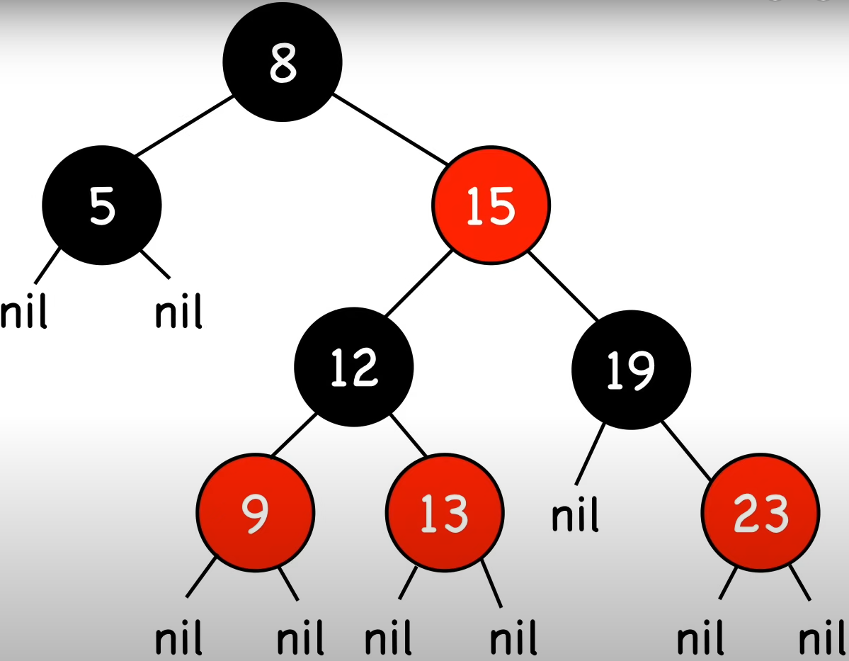
Red-Black Tree
Red-Black Tree: A balanced BST that maintains the invariant: the longest path (root to farthest NIL) is no more than twice the length of the shortest path (root to nearest NIL).
Right figure: Shortest path: all black nodes (=2); Longest path: alternating red and black (=4)
This is NOT a legal AVL tree as it does not satisfy AVL invariant at root |LeftHeight – RightHeight | <= 1
(Path from root in RBT includes the NIL node, whereas height of AVL tree does not.)
RBT uses color coding to maintain balance and reduce the number of node re-arrangements needed via rotations. It has four properties:
1. Node Color: A node is either red or black.
2. Root Property: The root and leaves (NIL) are black.
3. Red Property: If a node is red, then its children are black. (no two adjacent red nodes)
4. Black Property: All paths from a node to its NIL descendants contain the same number of black nodes.
Node insertion and deletion may result in violation of these properties.
Use recoloring and rotations to maintain these properties.
Notes:
(Note: this is NOT tree height since tree height does not ínclude NIL nodes)
Nodes require one storage bit to keep track of color.
The path excludes root node itself, so here each path contains 1 black node
Node Color: Each node is either red or black.
Root Property: The root of the tree is always black.
Red Property: Red nodes cannot have red children (no two consecutive red nodes on any path).
Black Property: Every path from a node to its descendant null nodes (leaves) has the same number of black nodes.
Leaf Property: All leaves (NIL nodes) are black.

Slide 32
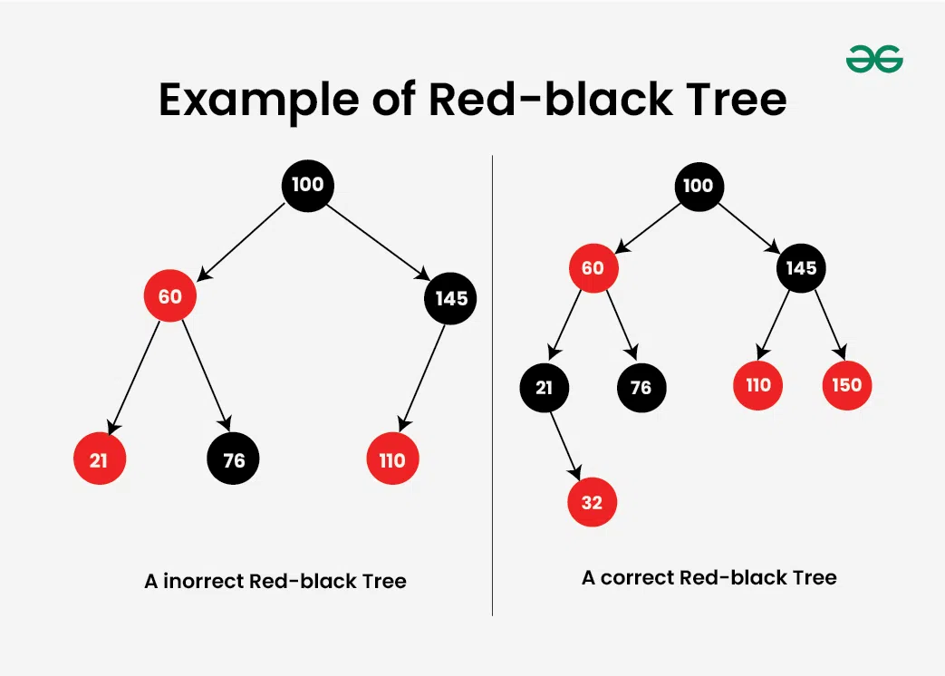
Examples
Tree on the left: Incorrect Red Black Tree.
Two red nodes are adjacent to each other.
One of the paths to a leaf node has zero black nodes, whereas the other two paths contain 1 black node each.

Slide 33
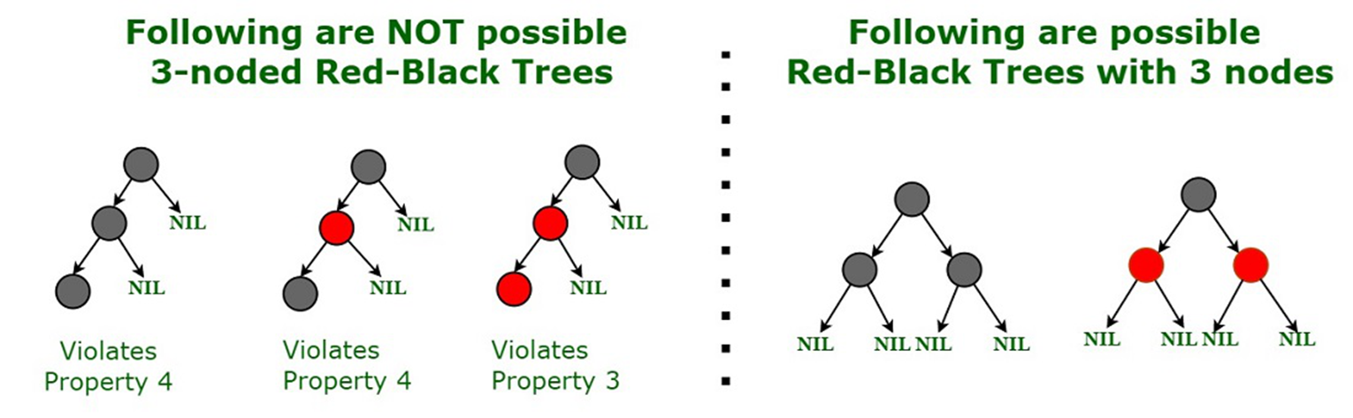
Red-Black tree ensures balancing
A linear chain of 3 nodes is not possible in a Red-Black tree

Slide 34
Additional Properties
AVL Tree: A balanced BST that maintains the invariant |LeftHeight – RightHeight | <= 1 for all nodes in the tree.

Slide 35
Insertion
Inserting a new node in a Red-Black Tree involves a two-step process: performing a standard binary search tree (BST) insertion, followed by fixing any violations of Red-Black properties.
Insertion Steps
BST Insert: Insert the new node into BST and color it red.
Fix Violations:
If the parent of the new node is black, no properties are violated.
If the parent is red, the tree might violate the Red Property, requiring fixes.

Slide 36
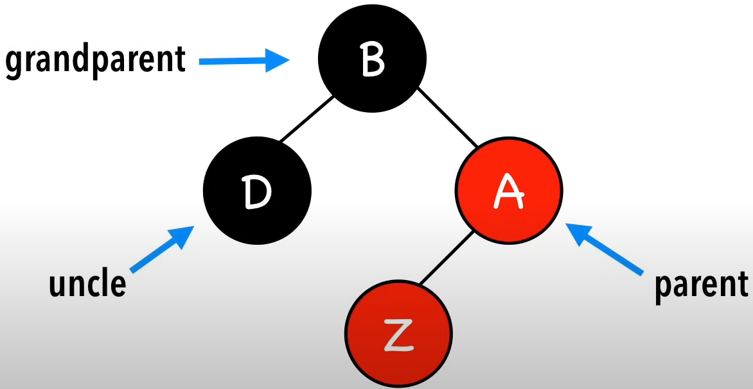
Insertion
Step 1. Insert Z and color it red
Step 2. Recolor and rotate nodes to fix violations
4 scenarios after inserting node Z
Case 0. Z = root
Color Z black
Case 1. Z.uncle = red
Recolor Z’s parents and grandparent
Case 2. Z.uncle = black (triangle)
Rotate Z.parent, turns into Case 3
Case 3. Z.uncle = black (line)
Rotate Z.grandparent & Recolor Z’s parents and grandparent
Notes:
When a node is first inserted it is initially marked “red”. then depending on its position it may either be changed to “black” or rotated to maintain balance. Insertion cases:
0. Node is the root
Color node black
1. Node’s uncle is red
recolor
2. Node’s uncle is black (Triangle)
Rotate node’s parent
3. Node’s uncle is black (line)
Rotate nodes’ grandparent & recolor

Slide 37


Case 0. Z = root
Color Z black
Color Z
black

Slide 38
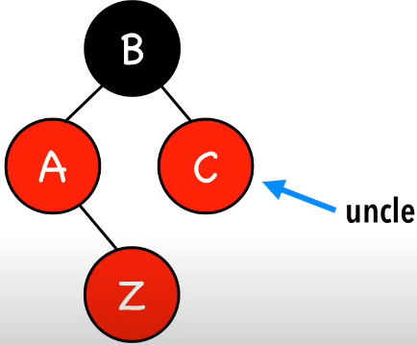
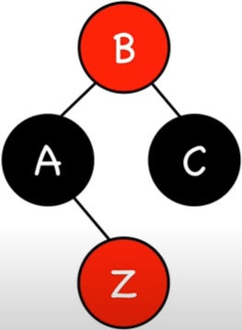
Case 1. Z.uncle = red
Recolor Z’s parent, uncle, and grandparent
recolor

Slide 39
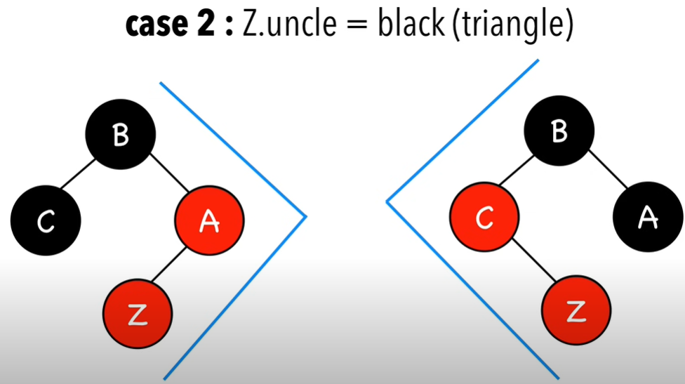
Case 2. Z.uncle = black (triangle)

Slide 40
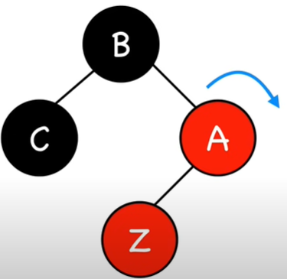
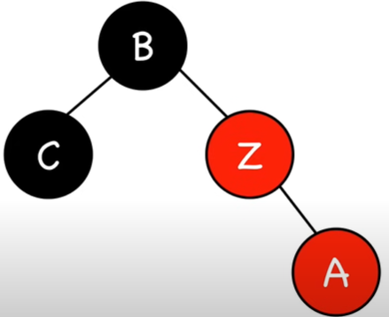
Case 2. Z.uncle = black (triangle)
Rotate Z.parent
Turns into Case 3
rotate
Z.parent

Slide 41
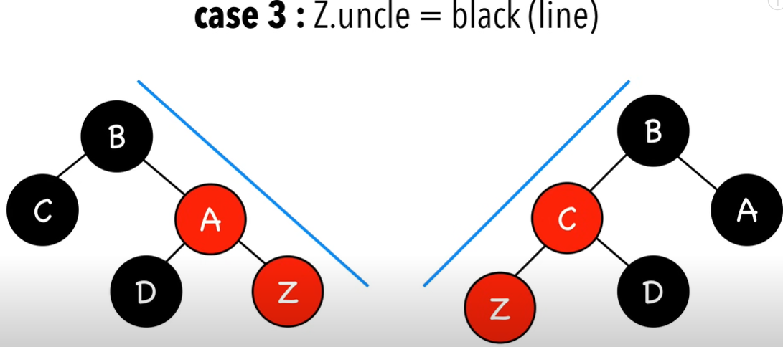
Case 3 Z.uncle = black (line)

Slide 42
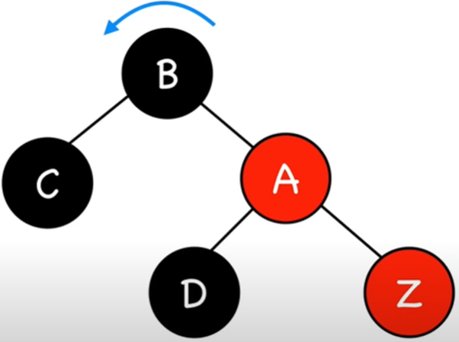
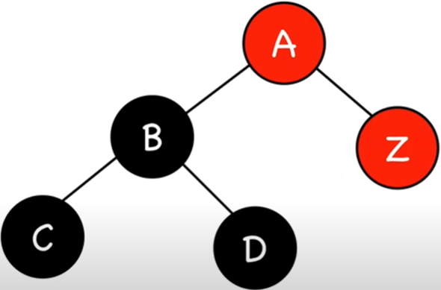
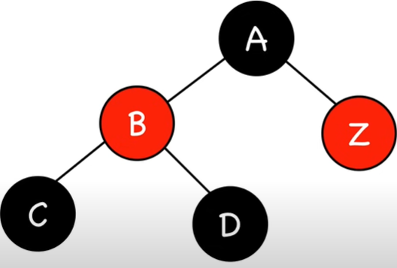
Case 3 Z.uncle = black (line)
Rotate Z.grandparent
rotate
Z.grandparent
recolor

Slide 43
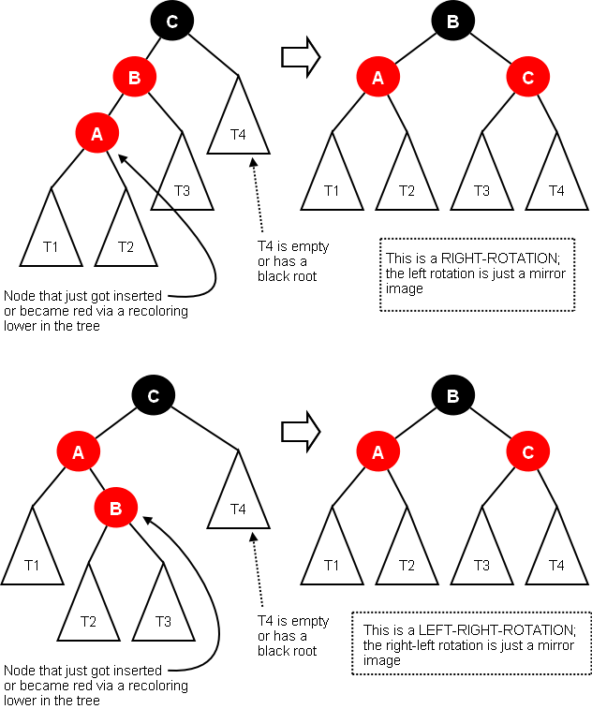
Case 3 Z.uncle = black
Notes:
https://cs.lmu.edu/~ray/notes/redblacktrees/

Slide 44
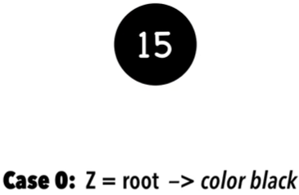
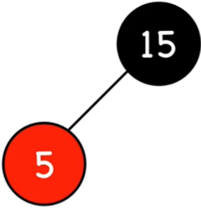
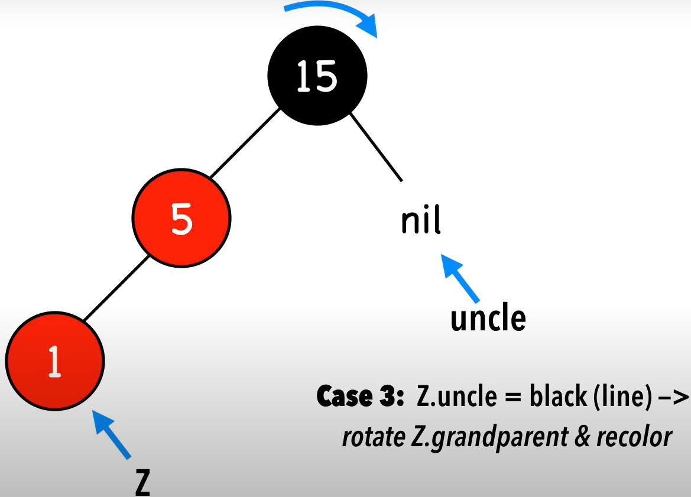
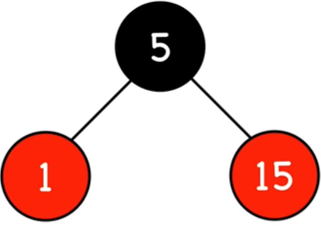
Example 1
insert 15
insert 5
insert 1

Slide 45
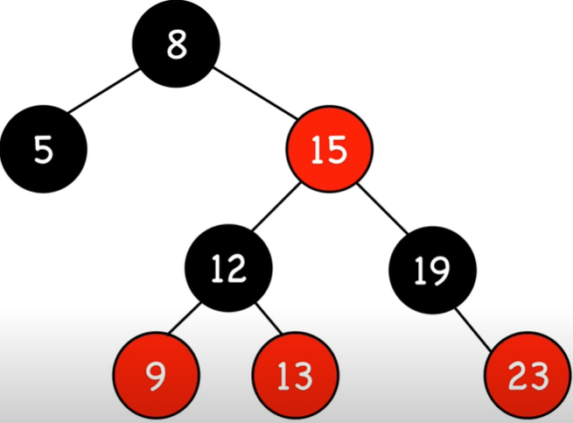
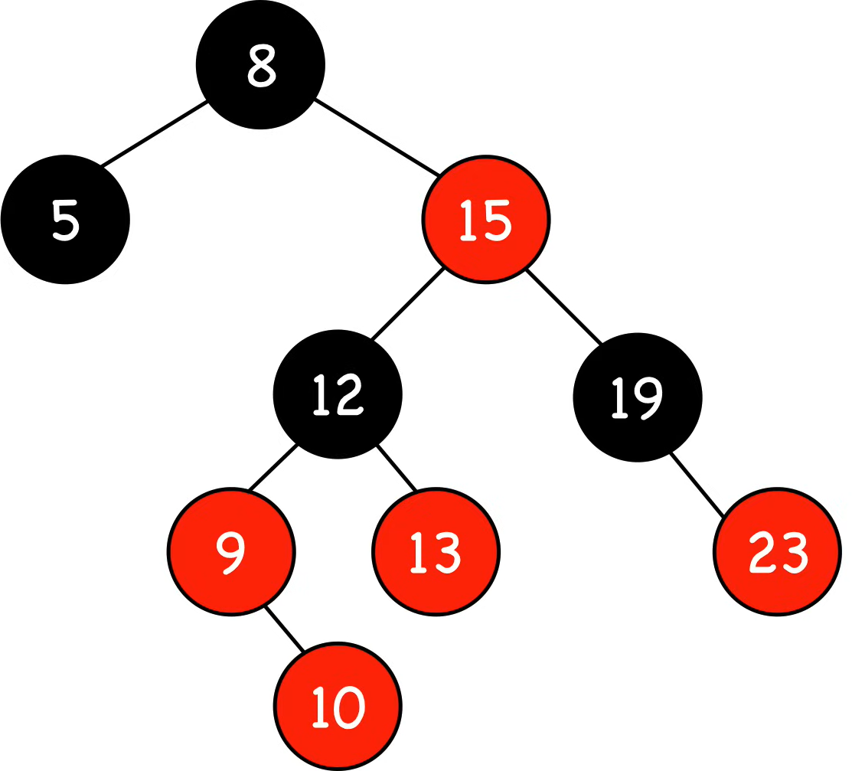
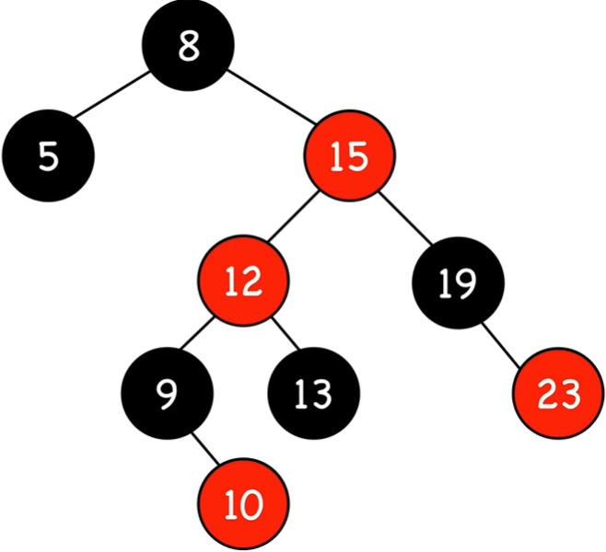
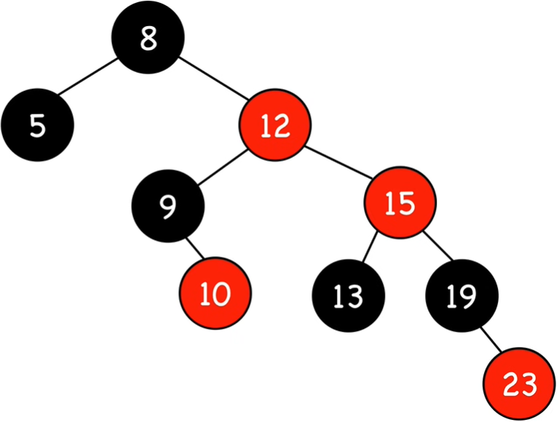
Example 2
insert 10
Z.uncle
Z
Case 2. Z.uncle = black
right rotate on 15
Z.uncle
Case 1. Z.uncle = red
recolor
Z.uncle
Z
Z

Slide 46
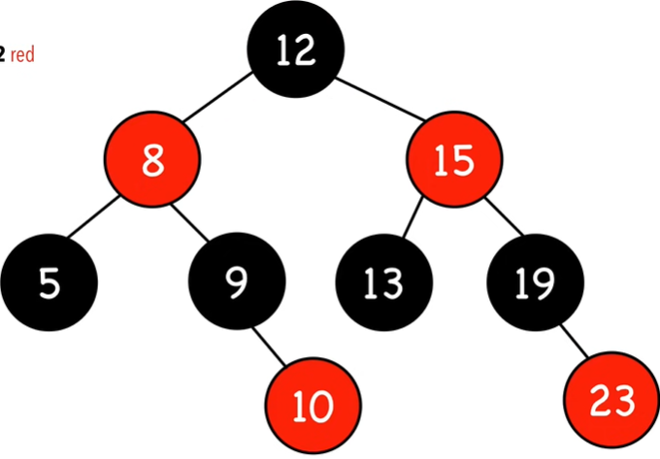
Example 2 Con’t
Case 2. Z.uncle = black
left rotate on 8 & recolor
Z.uncle
Z

Slide 47
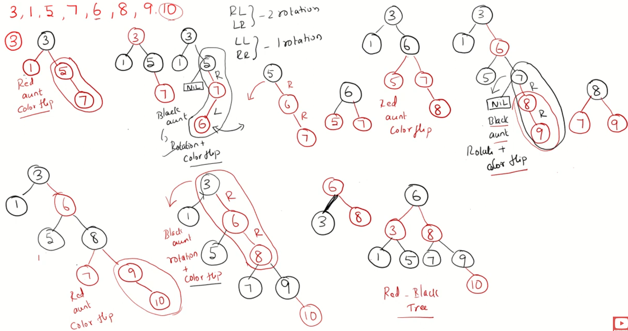
Another Example
Red Black Tree – Insertion
https://www.youtube.com/watch?v=9ubIKipLpRU

Slide 48
Time Complexity
1. Insert : O(log(n))
maximum height of red-black trees
2. Color red : O(1)
3. Fix violations :
Constant # of:
a. Recolor : O(1)
b. Rotation: O(1)
Overall time complexity: O(log(n))

Slide 49
AVL vs Red Black Trees
Red Black Tree:
A balanced BST that maintains the (more relaxed) invariant: the longest path (root to farthest NIL) is no more than twice the length of the shortest path (root to nearest NIL).
More efficient insertion and deletion operations because the balancing requirement is less strict than AVL Tree.
AVL Tree:
A balanced BST that maintains the (more strict) invariant: |LeftHeight – RightHeight | <= 1 for all nodes in the tree.
More efficient look up operation because of the strict balance requirement.
Notes:
Red–black trees are widely used as system symbol tables.
Java: java.util.TreeMap, java.util.TreeSet.
C++ STL: map, multimap, multiset.
Linux kernel: completely fair scheduler, linux/rbtree.h.
Emacs: conservative stack scanning.

Slide 50
Video Tutorials
Red-Black Trees // Michael Sambol
https://www.youtube.com/playlist?list=PL9xmBV_5YoZNqDI8qfOZgzbqahCUmUEin
Lecture slides based in this video series
Red Black Tree – Insertion, InvesTime
https://www.youtube.com/watch?v=9ubIKipLpRU&list=PLoW1nQhPBiz_h5wcmoZODnVnQK9Xja-Pi&index=4 ‘
5.17 Red Black Tree Insertion | Insertion Algorithm | Data Structure Tutorials, Jenny's Lectures CS IT
https://www.youtube.com/watch?v=qA02XWRTBdw&list=PLdo5W4Nhv31bbKJzrsKfMpo_grxuLl8LU&index=65
Introduction to Red-Black Tree
https://www.geeksforgeeks.org/introduction-to-red-black-tree/
Notes:
https://www.youtube.com/watch?v=A3JZinzkMpk
Lecture - 14 Red Black Trees
https://www.youtube.com/watch?v=JRsN4Oz36QU

Slide 51
Tries

Slide 52
Trie: An Introduction
L02: Dictionary ADT, Tries
CSE332, Spring 2021
Tries view its keys as:
a sequence of characters
some (hopefully many!) sequences share common prefixes
Each level of the tree represents an index in the string
Children at that level represent possible
characters at that index
This abstract trie stores the set of strings:
awls, a, sad, same, sap, sam
How to deal with a and awls?
Mark which nodes complete a string (shown in purple)
a
s
w
a
l
d
m
p
s
e
Notes:
Structure and Purpose
Trees:
General-purpose data structure for representing hierarchical relationships
Each node can contain any type of data
Nodes typically have a value and references to child nodes
Tries:
Specialized tree structure for storing and retrieving strings efficiently
Also known as a prefix tree
Optimized for operations on strings or sequences
Node Content
Trees:
Each node stores a value directly
Tries:
Nodes typically do not store complete strings
The path from the root to a node represents a string or prefix
Characters are stored along the edges between nodes

Slide 53
Searching in Tries
L02: Dictionary ADT, Tries
CSE332, Spring 2021
Two ways to fail a contains() check:
If we fall off the tree
If the final node isn’t purple (not a key)
Input String | Fall Off? / Is Key? | Result
contains(“sam”) | hit / purple | True
contains(“sa”) | hit / white | False
contains(“a”) | hit / purple | True
contains(“saq”) | fell off / n/a | False
a
s
w
a
l
d
m
p
s
e

Slide 54
Keys as “a sequence of characters”
L02: Dictionary ADT, Tries
CSE332, Spring 2021
Most dictionaries treat their keys as an “atomic blob”: you can’t disassemble the key into smaller components
Tries take the opposite view: keys are a sequence of characters
Strings are made of Characters
Tries are defined by 3 types:
An “alphabet”: the domain of the characters
A “key”: a sequence of “characters” from the alphabet
A “value”: the usual Dictionary value

Slide 55
Simple Trie Implementation
L02: Dictionary ADT, Tries
CSE332, Spring 2021
public class TrieSet {
private Node root;
private static class Node {
private char ch;
private boolean isKey;
private Map<char, Node> next;
private Node(char c, boolean b) {
ch = c;
isKey = b;
next = new HashMap();
}
}
}
a
s
w
a
l
d
m
p
s
e

Slide 56
Simple Trie Node Implementation
L02: Dictionary ADT, Tries
CSE332, Spring 2021
Node
private static class Node { private char ch;
private boolean isKey;
private Map<char, Node> next;
...
}
ch
a
isKey
true
next
Map
y
Node
ch | y
isKey | false
next
…
a
y

Slide 57
Simple Trie Implementation
L02: Dictionary ADT, Tries
CSE332, Spring 2021
public class TrieSet {
private Node root;
private static class Node { private char ch;
private boolean isKey; private Map<char, Node> next;
private Node(char c, boolean b) {
ch = c; isKey = b;
next = new HashMap();
}
}
}
a
s
a
...
s
w
...
a
w
...
a
l
...
d
...
l
...
d
...
...

Slide 58
Trie-Specific Operations
L02: Dictionary ADT, Tries
CSE332, Spring 2021
Prefix matching
Keys are sequences that can have prefixes
Longest prefix
longestPrefixOf("sample")
Want: {"sam"}
Prefix match
findPrefix("sa")
Want: {"sad", "sam", "same", "sap"}
a
s
w
a
l
d
m
p
s
e

Slide 59
Summary
L02: Dictionary ADT, Tries
CSE332, Spring 2021
A trie data structure implements the Dictionary and Set
Tries store sequential keys
… which enables very efficient prefix operations like findPrefix
Tries have many different implementations
Could store HashMap/TreeMap/any-dictionary within nodes
59
Notes:
Tries have many different implementations
Could store HashMap/TreeMap/any-dictionary within nodes

Slide 60
Full-Length Lectures
[CSE 373 WI24] Lecture 09: AVL Trees
https://www.youtube.com/watch?v=TPMH35DqGI0&list=PLEcoVsAaONjd5n69K84sSmAuvTrTQT_Nl&index=8
[CSE 373 WI24] Lecture 10: Self Balancing Trees
https://www.youtube.com/watch?v=kTml61C1e3U&list=PLEcoVsAaONjd5n69K84sSmAuvTrTQT_Nl&index=9

